Slide 1


INTERST RATE ON THE ECB DEPOSIT FACILITY
2026-2027 FORECASTS

Slide 2
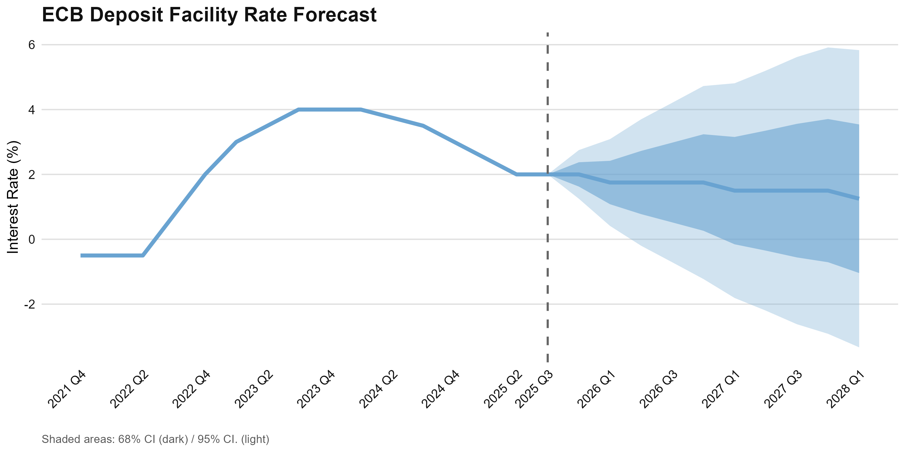
WE EXPECT A SERIES OF RATE CUTS SUMMING UP TO 75BPS BY Q1 2028
Executive Summary | ECB Deposit Facility Rate Forecast
Three 25bps Rate Cuts Forecast Through 2028
We expect the ECB to implement a gradual easing cycle with three 25bps rate cuts in Q1 2026, Q1 2027, and Q1 2028, bringing the deposit facility rate from 2.00% to a terminal rate of 1.25% Q1 2028.
Current Rate
2.00%
Q1 2026
1.75%
First cut as slack emerges
October 30, 2025
Q1 2027
Forward Guidance
Data-Dependent:
Based on inflation projections and policy transmission
No Preset Path:
Full discretion, no predetermined trajectory
1.50%
Negative output gap
Q1 2028
1.25%
Terminal rate
Key Drivers: Persistent inflation close to the 2% target (2.07-2.10%), deteriorating output gap turning negative by Q3 2027, and downside risks from US tariff uncertainty and labor market weakness.

Slide 3
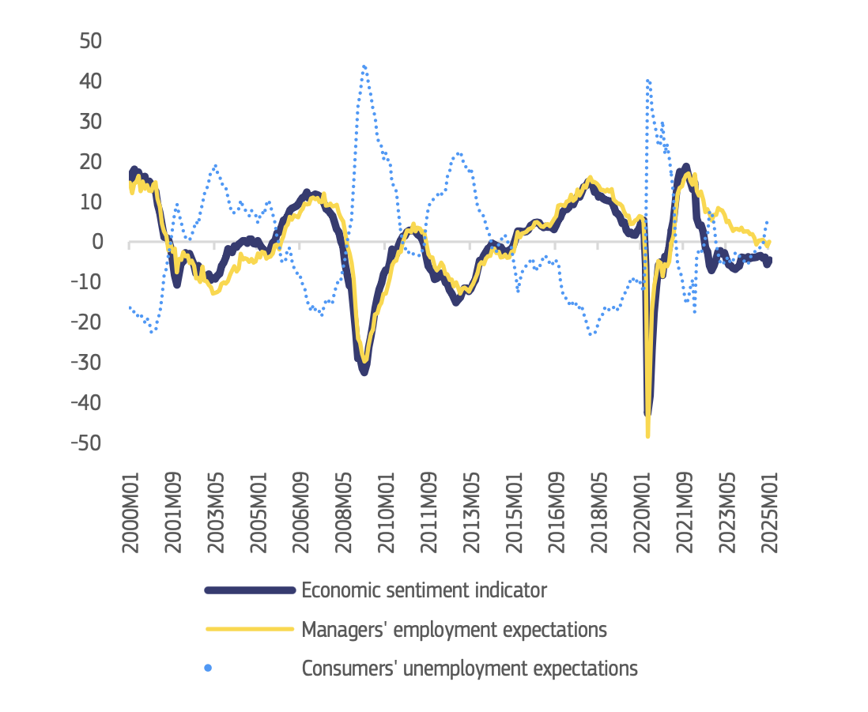
RATE CUTS DRIVEN BY TARIFFS AND LABOR MARKET EXPECTATIONS
Executive Summary | Rationale
Current Rate
Cumulative rate cuts
EU economic sentiment and employment expectations
(relative to pre-pandemic average)
2.00%
75bps
October 30, 2025
Until Q1 2028
Underlying Rationale
Downside risk due to US Tariffs
Uncertainty associated with US tariffs may lead to delays in investment, hiring, and spending decisions in addition to the direct effects on exports
Weak labor market
Reduction in hiring intentions and pessimism regarding economic outlook
Monetary policy leeway
Inflation sticking close to target allowing the implementation of accommodative monetary policy
Source: European Commission (2025)
Notes:
“The European labour market remains resilient, with low unemployment levels, despite a decline in employment growth, according to the European Commission's latest Labour Market and Wage Developments in Europe report.”
“The overall impact of a 15 percentage point increase in US tariffs on employment is estimated to be between 135 000 and 450 000 jobs with the effects being distributed unevenly across sectors and countries.” European Commission (2025, Labour Market and Wage Developments in Europe report)
“The recent decline in manufacturing employment raises concerns about the service sector’s ability to fully absorb displaced workers. Unlike in the past, this shift is not accompanied by stronger productivity growth in manufacturing compared to services, potentially limiting future employment and income gains.” European Commission (2025, Labour Market and Wage Developments in Europe report)
“While labour market outcomes have been favourable in recent years, the sustainability of high employment growth is increasingly challenged by structural trends. Demographic change is slowing labour force expansion and driving labour and skill shortages, which in turn risks to hamper the EU growth potential and EU’s competitiveness. The recent decline in manufacturing employment raises concerns about the service sector’s ability to fully absorb displaced workers. Unlike in the past, this shift is not accompanied by stronger productivity growth in manufacturing compared to services, potentially limiting future employment and income gains. The EU’s persistently weak productivity growth – especially compared to other advanced economies like the United States – is a major challenge, undermining competitiveness, job creation, and economic resilience. Rising global trade uncertainty poses short- and long-term employment risks, notably for countries and sectors more reliant on international trade.” European Commission (2025, Labour Market and Wage Developments in Europe report)

Slide 4
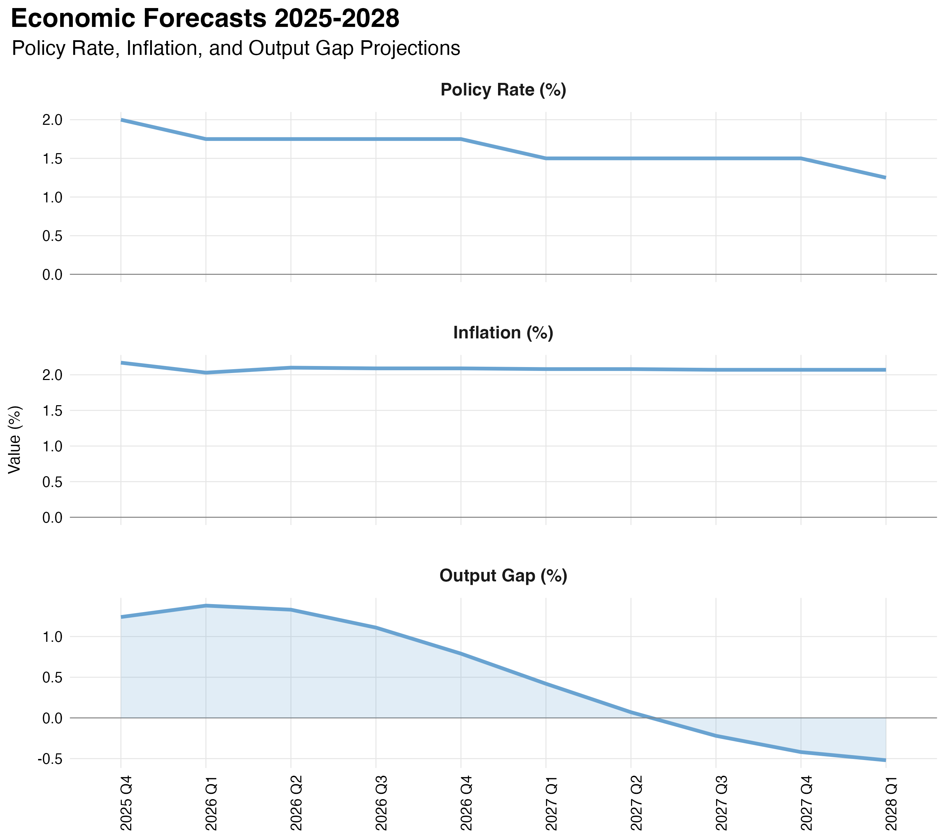
WE EXPECT THREE CONSECUTIVE 25BPS CUTS (2026, 2027, 2028)
Forecasts | ECB interest rate on the deposit facility
EASING TRAJECTORY
Three consecutive 25bps cuts in Q1 of each year
(2026, 2027, 2028)
CUMULATIVE REDUCTION
75 basis points over three-year horizon
TERMINAL RATE
1.25% by Q1 2028, above effective lower bound
Assessment: Calibrated response to support economic activity and ensure inflation stabilizes at 2% target

Slide 5
INFLATION IS EXPECTED TO STAY AROUND TARGET
Forecasts | Euro-zone Inflation Dynamics
PERSISTENT BUT SLIGHTLY ABOVE TARGET
7-17bps above ECB target
STARTING POSITION
2.17%
Q4 2025: 17bps above target
FORECAST END
2.07%
Q1 2028: 7bps above target
Assessment: Sticky inflation justifies gradual easing

Slide 6
MODEL PREDICTS A NEGATIVE OUTPUT GAP FROM Q3 2027 ONWARDS
Forecasts | Euro-zone Output Gap
STARTING POSITION
+1.24%
Q4 2025: Economy above capacity
TRANSITION POINT
Gap turns negative in Q3 2027
FORECAST END
-0.52%
Q1 2028: Below-potential
Assessment: Our model may underestimate slack

Slide 7
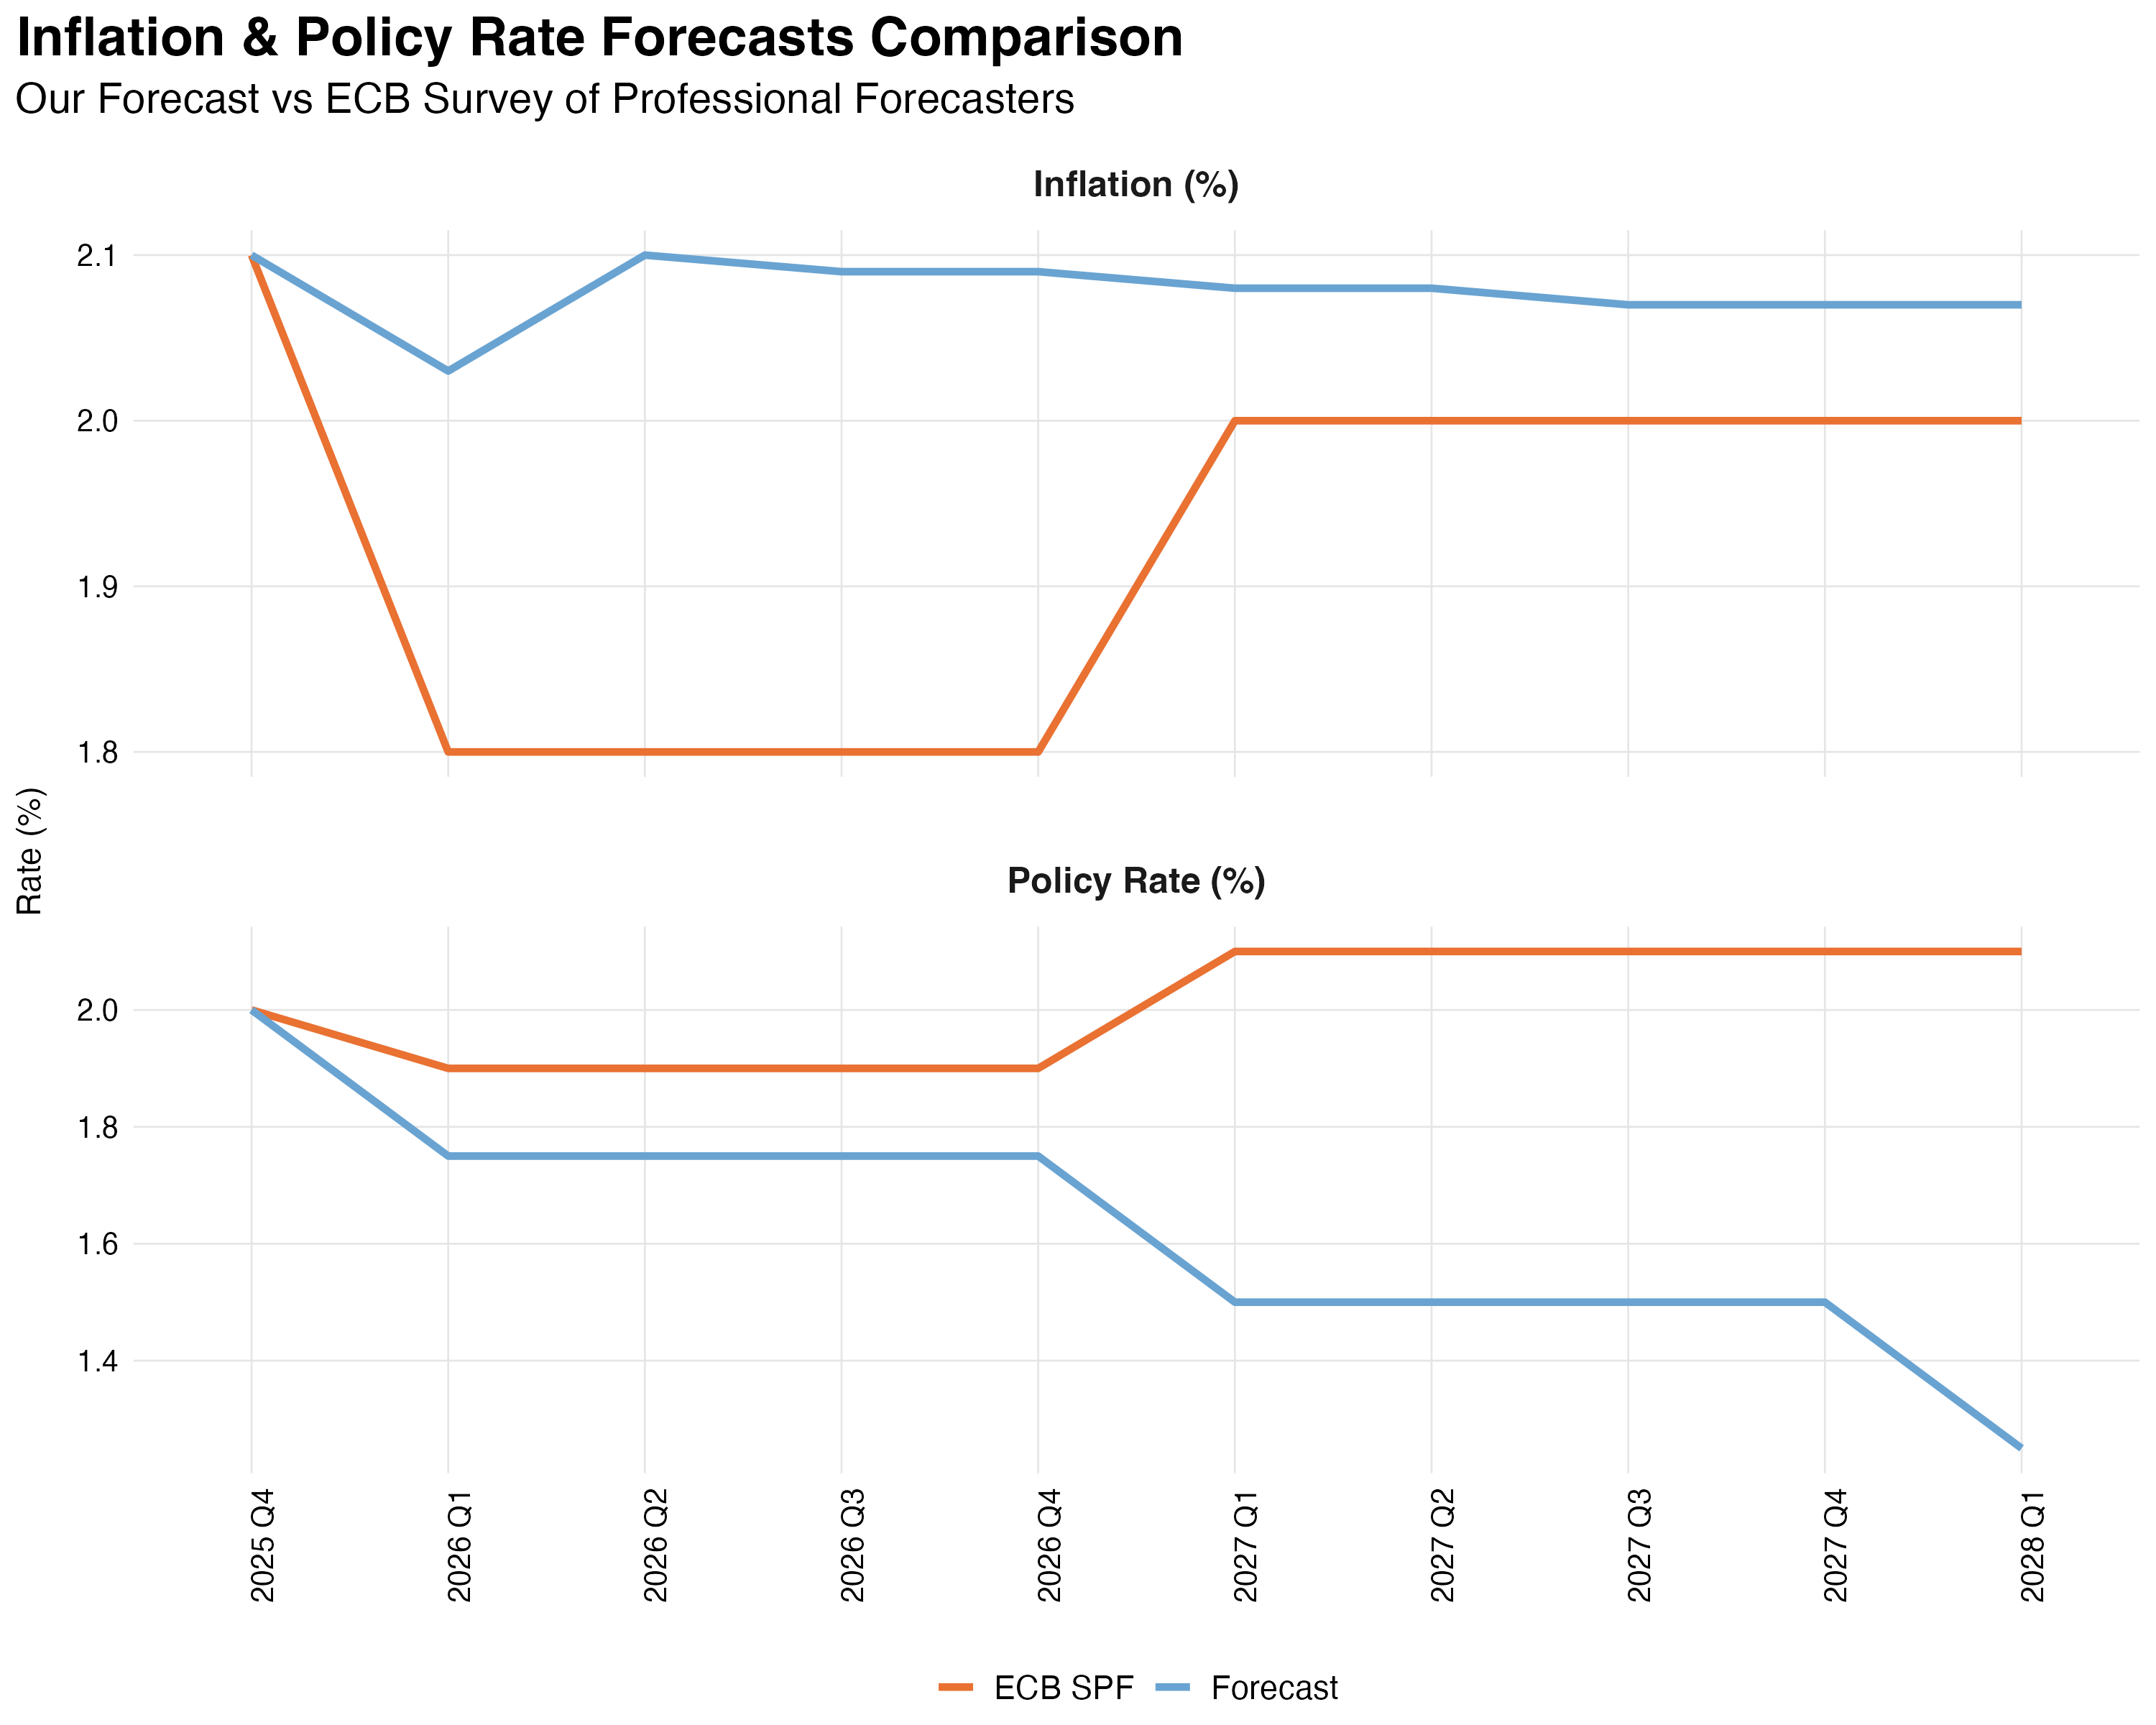
OUR FORECAST CONTRASTS WITH THE ECB SPF CONSENSUS
Analysis | Comparison with ECB SPF Consensus
OUR FORECAST
Sustained easing to 1.25% by 2028
Persistent weakness requiring prolonged accommodation
ECB SPF CONSENSUS
Brief cut to 1.90%, then reversal to 2.10%
Resilient economy requiring return to restrictive policy
INFLATION DIVERGENCE
Our forecast: 2.07-2.10% (persistently above)
SPF: 1.8% in 2026, recovering to 2.0%
Assessment: We anticipate wider negative output gap
Notes:
Assessment – Divergence from Consensus:
Our sustained low-rate forecast contrasts with SPF's policy normalization, reflecting different assessments of underlying economic dynamics:
The ECB SPF consensus seem to view any near-term weakness as cyclical rather than structural allowing policy normalization by 2027.
Our forecast with its sustained low-rate environment, implies greater concern about persistent economic slack requiring the ECB to maintain accommodation for longer.

Slide 8
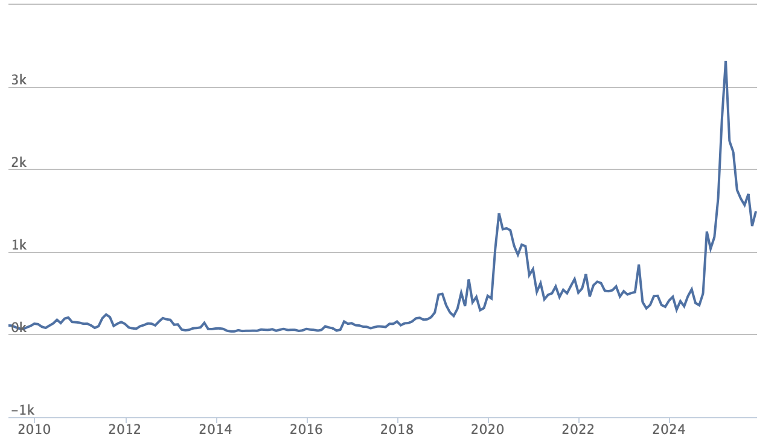
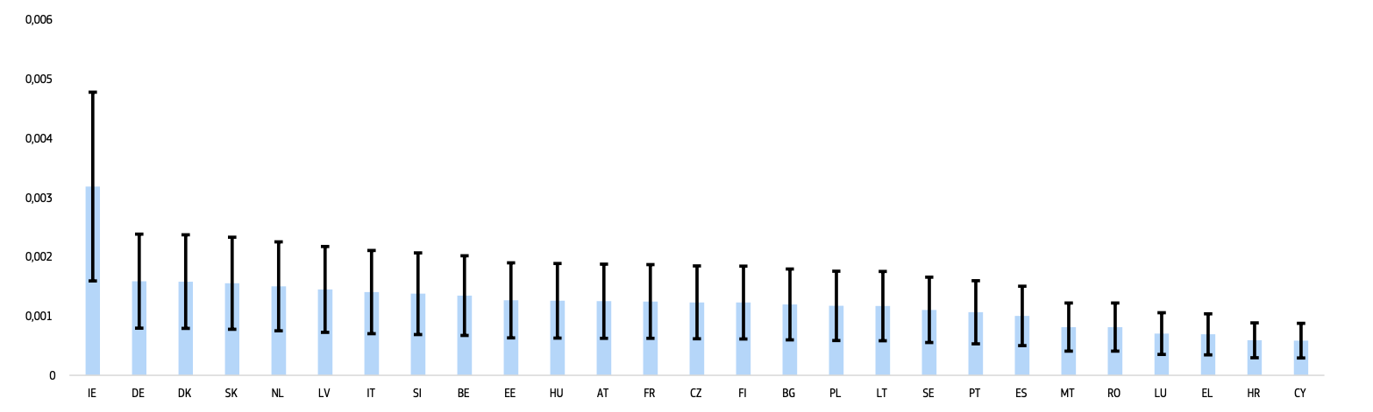
SPF CONSENSUS MAY UNDERSTIMATE EFFECTS OF US TARIFFS
Analysis | Rationale for divergence
Indirect effects
Uncertainty associated with US tariffs may lead to delays in investment, hiring, and spending decisions
Daily Trade Policy Uncertainty
(US news-based metric, 7-day moving average)
Direct effects
Higher tariffs could directly impact EU economic activity, especially employment through an increase in export prices
Expected employment decline due to US tariffs by country
(Lower and upper range refers to 0.1% and 0.3% respectively)
Source: European Commission (2025)
Source: Baker et al. (2025)
Assessment: The assumed reduction in exports to the US is expected to have a significant impact on some sectors and tariffs may put additional pressure on an already weaking labor market
Notes:
Trade Policy Uncertainty Index reflects the frequency of articles in American newspapers that discuss policy-related economic uncertainty and also contain one or more references to trade policy.
“The European labour market remains resilient, with low unemployment levels, despite a decline in employment growth, according to the European Commission's latest Labour Market and Wage Developments in Europe report.”
“The overall impact of a 15 percentage point increase in US tariffs on employment is estimated to be between 135 000 and 450 000 jobs with the effects being distributed unevenly across sectors and countries.” European Commission (2025, Labour Market and Wage Developments in Europe report)
“The recent decline in manufacturing employment raises concerns about the service sector’s ability to fully absorb displaced workers. Unlike in the past, this shift is not accompanied by stronger productivity growth in manufacturing compared to services, potentially limiting future employment and income gains.” European Commission (2025, Labour Market and Wage Developments in Europe report)
“While labour market outcomes have been favourable in recent years, the sustainability of high employment growth is increasingly challenged by structural trends. Demographic change is slowing labour force expansion and driving labour and skill shortages, which in turn risks to hamper the EU growth potential and EU’s competitiveness. The recent decline in manufacturing employment raises concerns about the service sector’s ability to fully absorb displaced workers. Unlike in the past, this shift is not accompanied by stronger productivity growth in manufacturing compared to services, potentially limiting future employment and income gains. The EU’s persistently weak productivity growth – especially compared to other advanced economies like the United States – is a major challenge, undermining competitiveness, job creation, and economic resilience. Rising global trade uncertainty poses short- and long-term employment risks, notably for countries and sectors more reliant on international trade.” European Commission (2025, Labour Market and Wage Developments in Europe report)

Slide 9
WE EXPECT A SERIES OF RATE CUTS SUMMING UP TO 75BPS BY Q1 2028
Conclusion | ECB Deposit Facility Rate Forecast
Three 25bps cuts through 2028 in response to moderating inflation and deteriorating output gap
Q1 2026
Q1 2027
Q1 2028
1.75%
1.50%
1.25%
First cut as slack emerges
Negative output gap
Terminal rate
Underlying Rationale
Downside risk due to US Tariffs
Uncertainty associated with US tariffs may lead to delays in investment, hiring, and spending decisions in addition to the direct effects on exports
Weak labor market
Reduction in hiring intentions and pessimism regarding economic outlook
Monetary policy leeway
Inflation sticking close to target allowing the implementation of accommodative monetary policy
Divergence with Consensus: we expect a wider output gap driven by uncertainty associated with US tariffs

Slide 10
THANK YOU
ANY QUESTIONS?

